Slide 1
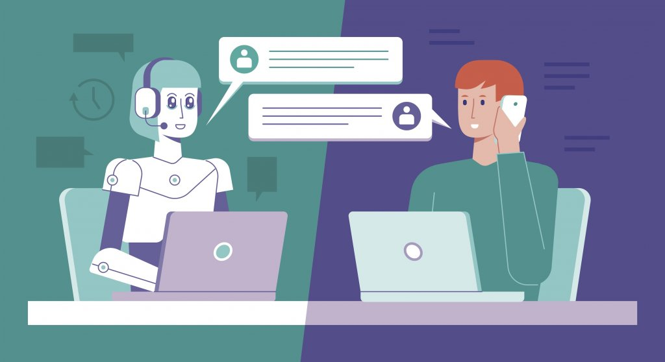
CHAT BOT

Slide 2
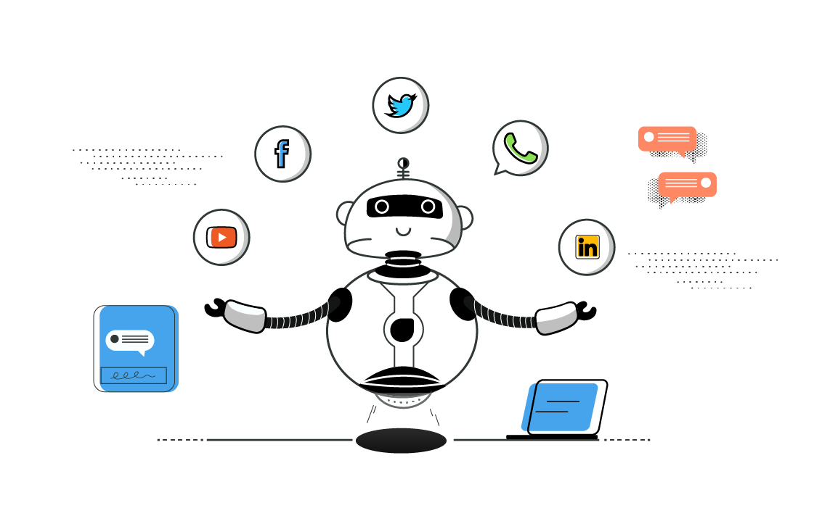
CHATBOT
Under the esteemed guidance of
Dr. G. MADHAVI
Assistant Professor & HOD(I/C) Presented by:
Department of CSE BANDI RAMA KRISHNA (20031A0508)
UNCEN JNTUK

Slide 3
CONTENTS
Abstract
Introduction
Brief on ChatBots
Need of ChatBots
Types of ChatBots
Rule-Based ChatBots vs Self-learning ChatBots
Working of Chatbot
ChatBot using Python
Advantages of ChatBots
Drawbacks
UML DIAGRAMS
REFERENCES

Slide 4
ABSTRACT
Data science encompasses a set of principles, problem definitions, algorithms, and processes for extracting nonobvious and useful patterns from large data sets. Many of the elements of data science have been developed in related fields such as machine learning and data mining.
Data science is the study of data to extract meaningful insights for business.

Slide 5
INTRODUCTION
Chatbots, also known as conversational agents, are designed with the help of AI (Artificial Intelligence) software. They simulate a conversation (or a chat) with users in a natural language via messaging applications, websites, mobile apps, or phone.
Chatbots can be utilized for various reasons. But one fundamental reason that organizations adapt to chatbots is the reliable customer service and customer engagement.
Chatbots enhance user experiences and increase the value of the organization.

Slide 6
Brief on ChatBots
“A chatbot or chatterbot is a software application used to conduct an on-line chat conversation via text or text-to-speech, in lieu of providing direct contact with a live human agent”.
ChatBots are one of the most frequently seen AI around us in our daily life!
In 1950, Alan Turning proposed what is now called the Turing test as a criterion of intelligence.
The first chatbot was Eliza created in 1966.
ELIZA’S key method of operation involved the recognition of clue words of phrases in the input, and the output of the corresponding pre-prepared or pre-programmed responses that can move the conversation forward in an apparently meaningful way

Slide 7
NEED OF CHATBOTS
The applications of AI is indefinite and so is for Chatbots.
Several companies use chatbots for their internal and external use –
Messaging Apps
Customer Service
Company internal use
FB bots of companies Hike - Natasha
Swiggy Bot,
Zomato Bot, Vogo Bot
Internal HR bot, Internal Finance tool bot

Slide 8
Types of ChatBots
Simple chatbots – Simple chatbots have limited capabilities, and are usually called rule-based bots. They are task-specific.
Smart chatbots – AI enabled smart chatbots are designed to simulate near-human interactions with customers.
Hybrid chatbots – They are a combination of simple and smart chatbots.
Social Messaging Chatbots - Social chatbots or intelligent dialogue systems have the capability to engage in conversations with humans.
Menu based chatbots - As the name suggests, these chatbots offer the user to choose from several options, presented in the form of menus or buttons.

Slide 9
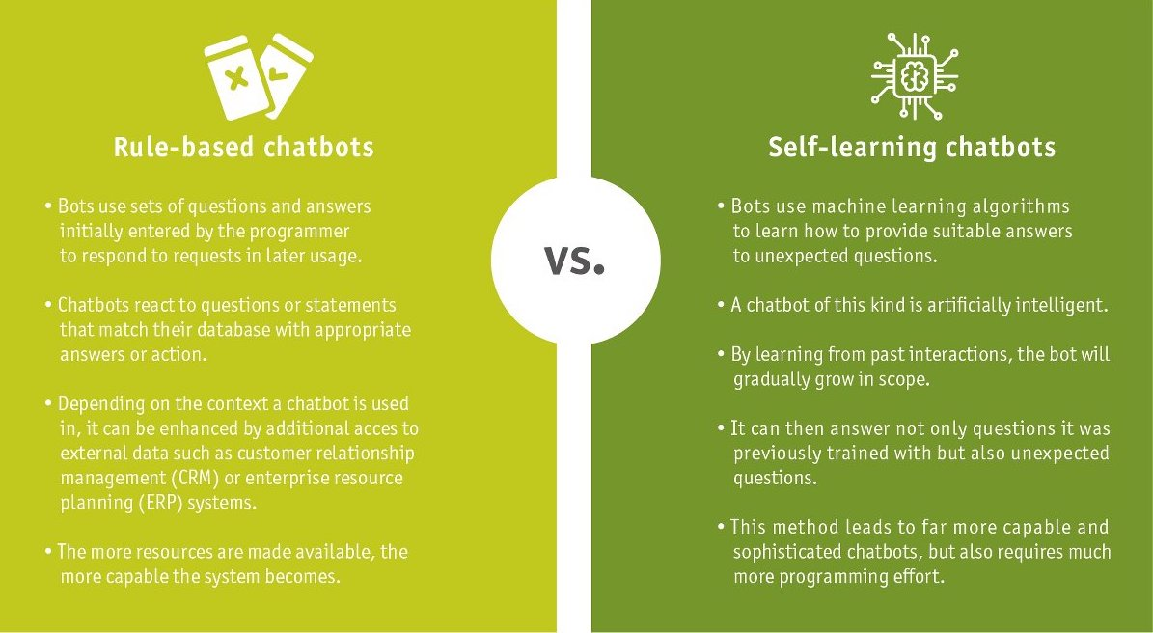
RULE BASED VS SELF LEARNING CHATBOTS

Slide 10
WORKING OF CHATBOT
FLOW CHART
User Message
Intent Classification
Entity Resolution
Intent
AI - Brain
Entities
Response selection
Response with highest similarity

Slide 11
ChatBot using Python
Chatbots can provide real-time customer support and are therefore a valuable asset in many industries. When you understand the basics of the ChatterBot library, you can build and train a Rule-Based chatbot with just a few lines of Python code.
Steps involved in building Chatbot with Python and NLTK
Reading Text corpus
Pre-Processing(Stop words Removal, Lower case conversion etc)
Tokenization, Stemming & Lemmatization
Bag of Words
One hot encoding

Slide 12
Python Code for Rule-Based chatbot
Python code for building a rule-based chatbot is given in the below link
https://drive.google.com/drive/folders/1Be0_9E2zKPP1FdM6xTYAFHVbueVUvh6J?usp=share_link
The codes inside the link are written by own with some youtube and google references by searching and learning with it.
There are two codes one is the importing code for another code.
Long_responses.py is the importing code in the code of main1.py.
By saving and executing the main1.py code in python or visual studio with suitable platform you can get the result or output.
The outputs are provided in the screenshots in next slides.

Slide 13
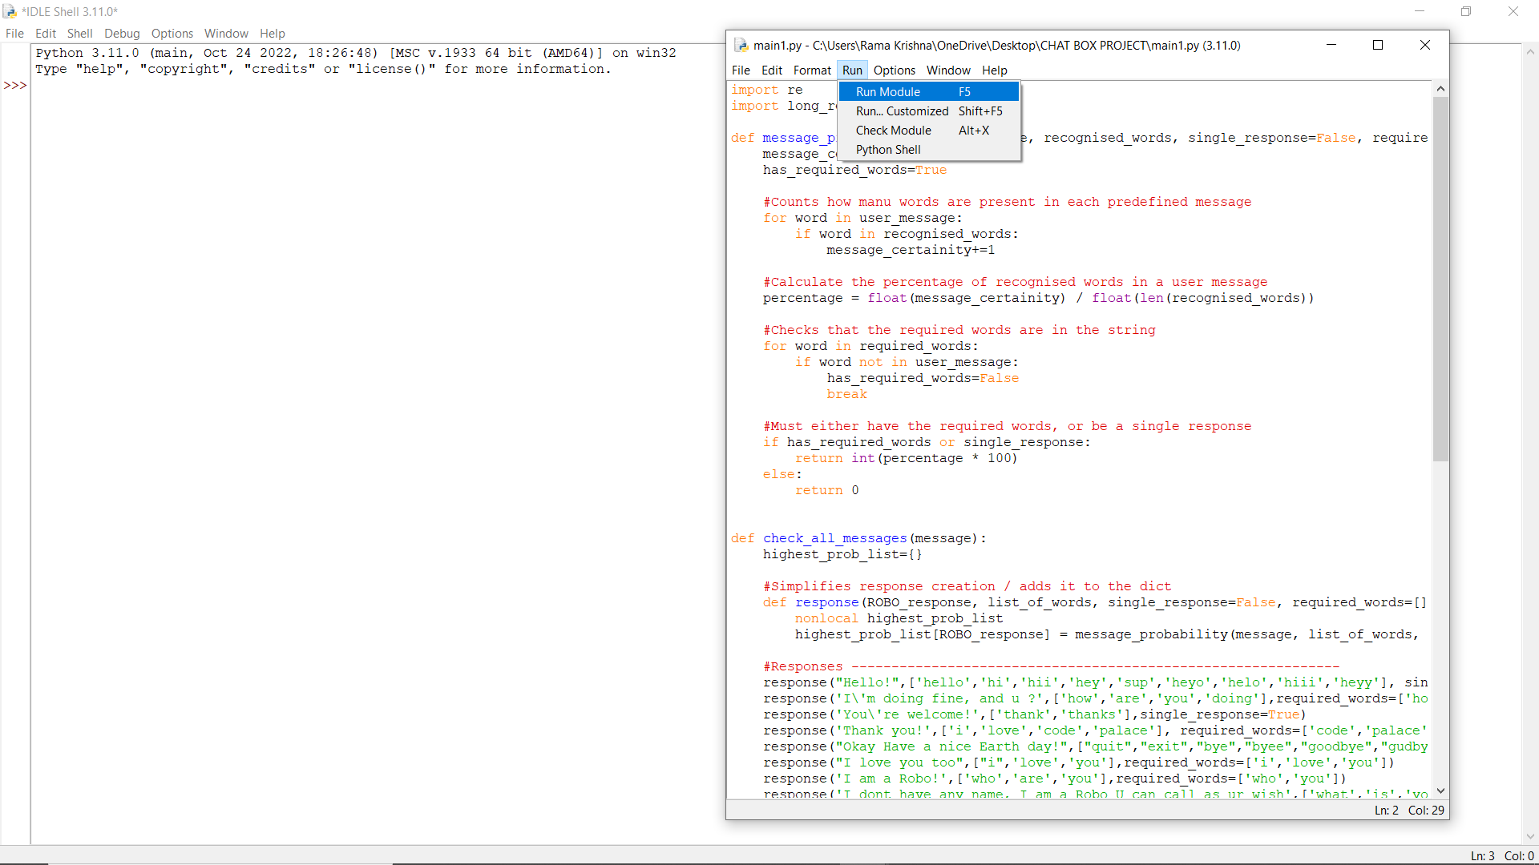
Running and Executing chatbot:
The running and execution process is shown in the below slides of screenshots.

Slide 14
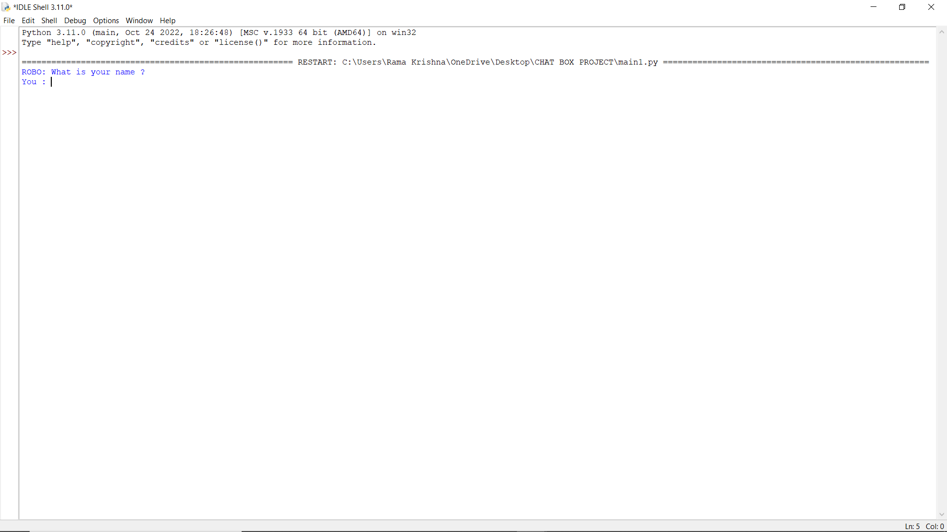
Executing

Slide 15
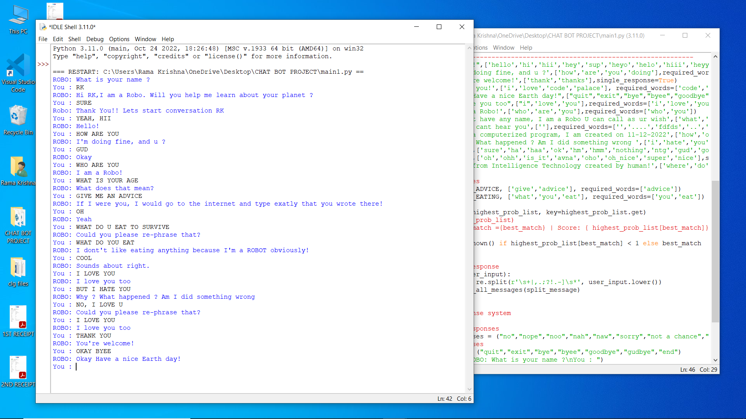

Slide 16
Advantages
While rule-based bots have a less flexible conversational flow, these guard rails are also an advantage. You can better guarantee the experience they will deliver, whereas chatbots that rely on machine learning are a bit less predictable.
Some other advantages of a rule-based chatbot are that they:
are generally faster to train (less expensive)
integrate easily with legacy systems
streamline the handover to a human agent
are highly accountable and secure
can include interactive elements and media
are not restricted to text interactions.

Slide 17
DRAWBACKS
Needs Analyzing:
To ensure that the chatbot provides the correct information to the customer. It’s natural for users’ and businesses’ goals to vary as a result of their engagements. Therefore, the chatbot must be updated with the correct information to meet client demands.
Less Understanding of Natural Language:
People in today’s world use shortcut keys to speed up responses and increase efficiency. As a result, chatbots are unable to adapt their language to that of humans. So slang, misspellings, and sarcasm are frequently misunderstood by bots. It means that a chatbot is unacceptable for a friendly discussion.
Higher Misunderstanding :
A computer program that is set up to answer questions from a database. When a user asks a question that isn’t in the chatbot’s database. The chatbot is unable to respond. These queries are likely to confuse chatbots, which will send them in loops.. By trying to understand the question, the bot will avoid leaving you without an answer.
Not Satisfied Angry Customer:
Sometimes customers cannot find the information they need or are unable to communicate with support executive connect. Because they did not enter the correct command. Because a chatbot is a programmed software with a specified response, if a consumer does not provide the correct command, they will not give the correct response, which makes them upset or frustrated with the company’s services. However, there is a major risk of losing clients.

Slide 18
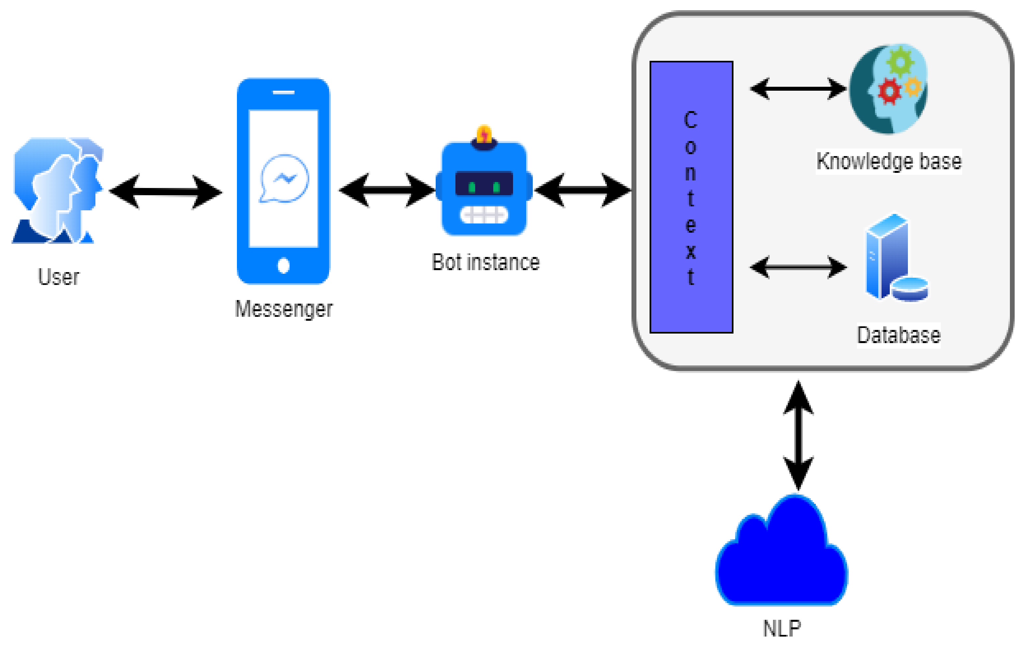
CHATBOT ARCHITECTURE

Slide 19
UML DIAGRAMS USED IN DESIGN
Data flow diagram
Use case diagram
Class diagram
Sequence diagram
Communication diagram
Activity diagram

Slide 20
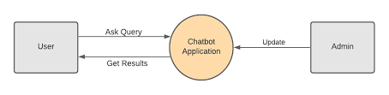
DATA FLOW DIAGRAM
CONTEXT LEVEL DFD

Slide 21
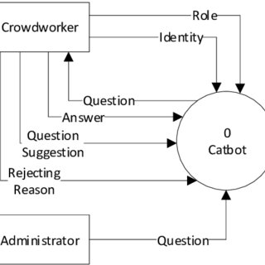
Level – 1 DFD

Slide 22
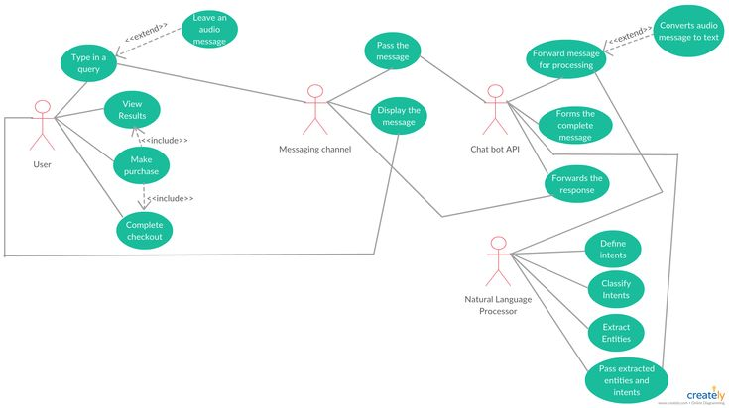
USECASE DIAGRAM

Slide 23
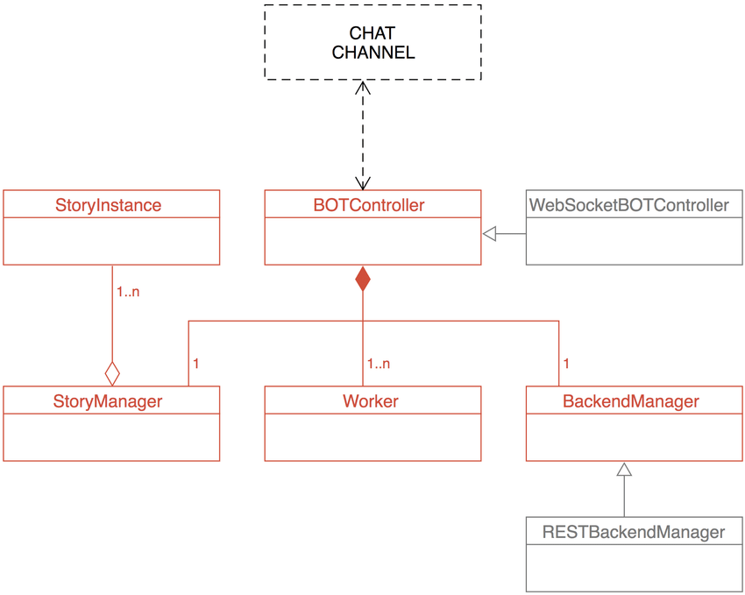
CLASS DIAGRAM

Slide 24
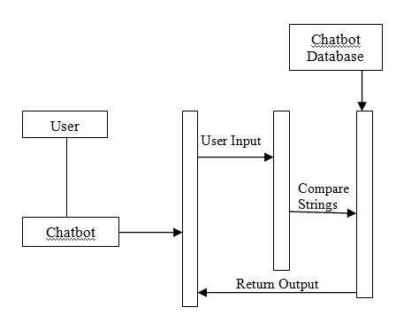
SEQUENCE DIAGRAM

Slide 25
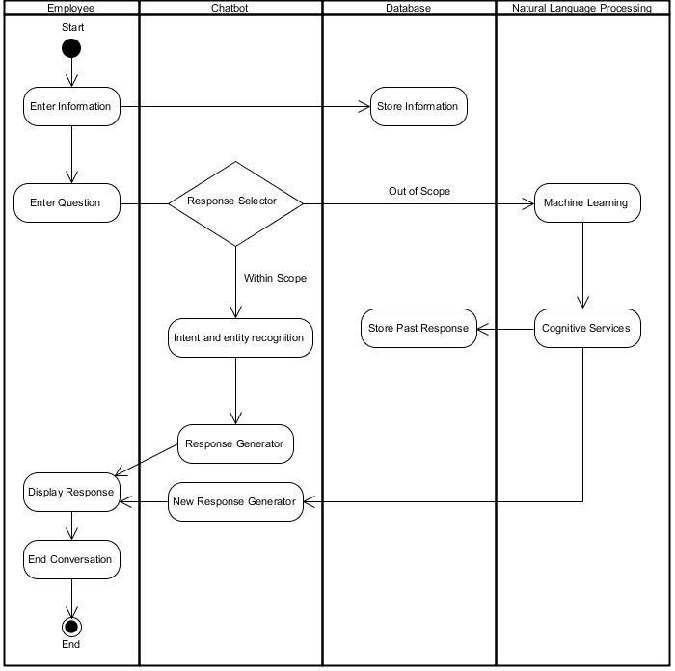
ACTIVITY DIAGRAM

Slide 26
REFERENCES
First reference is the skilldzire app from where I choose course and learn course it topic wise.
And the second one is google. https://www.google.com/search/
Third one is youtube. https://www.youtube.com/

Slide 27
THANK YOU

